Slide 1
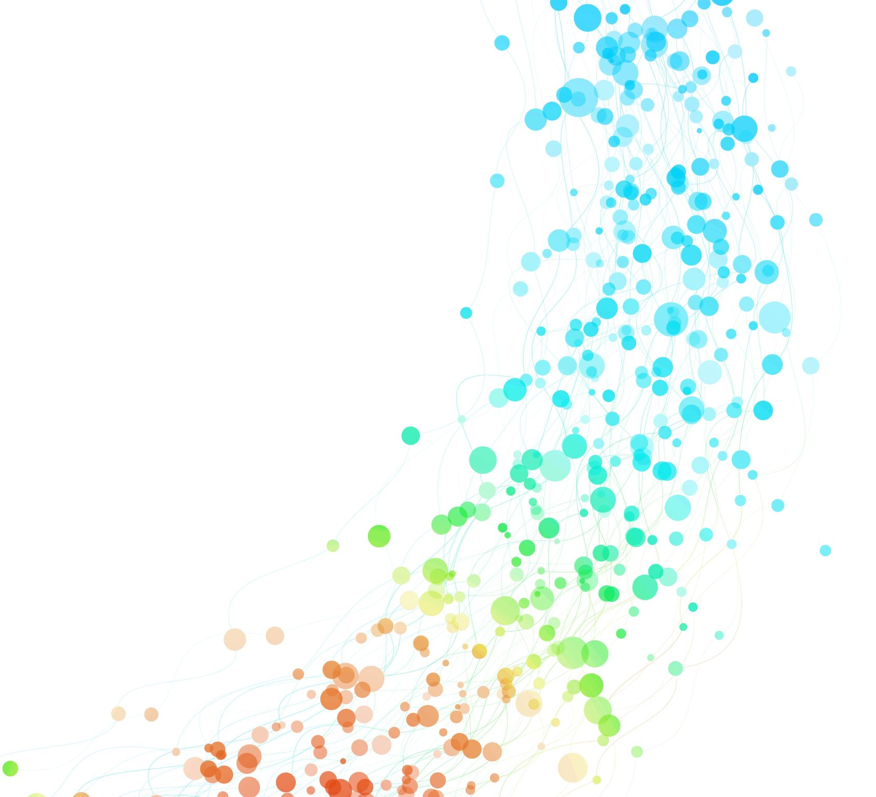
data transparency USING violin PLOTS
Samantha Roberts 6135 Data Visualization

Slide 2
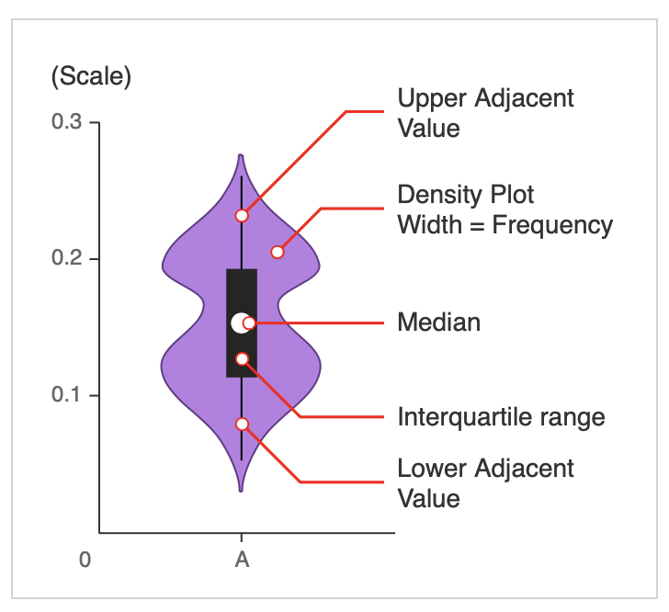
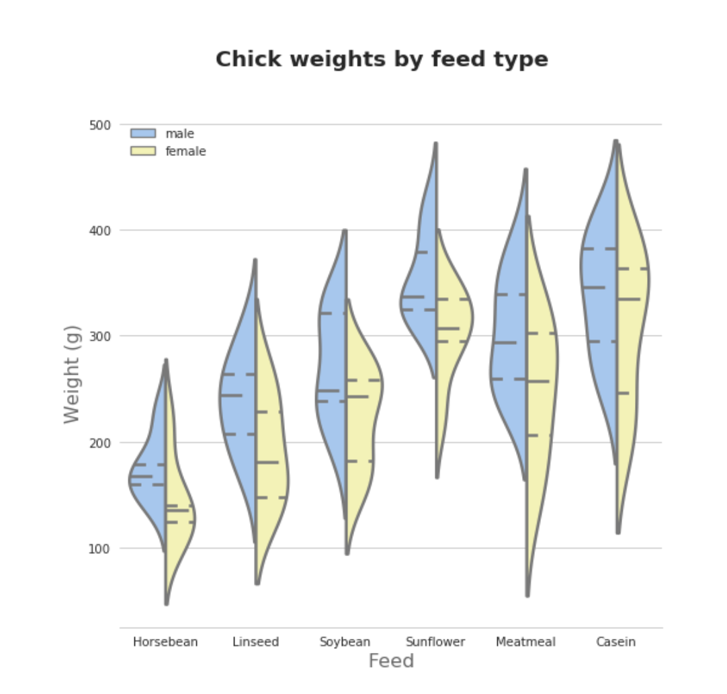
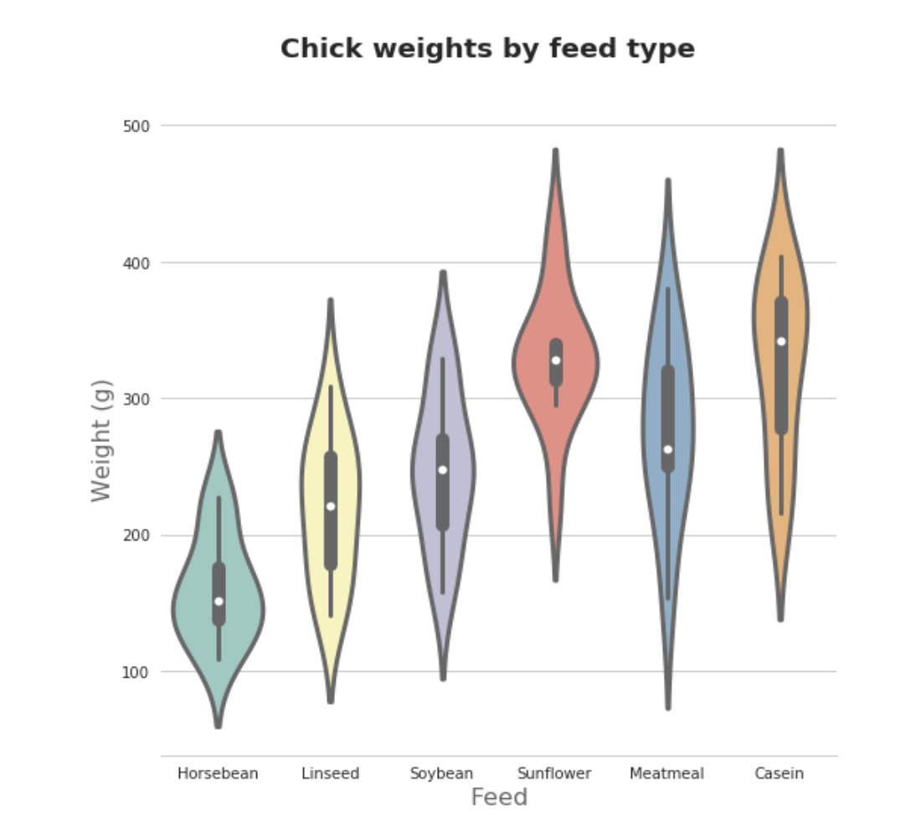
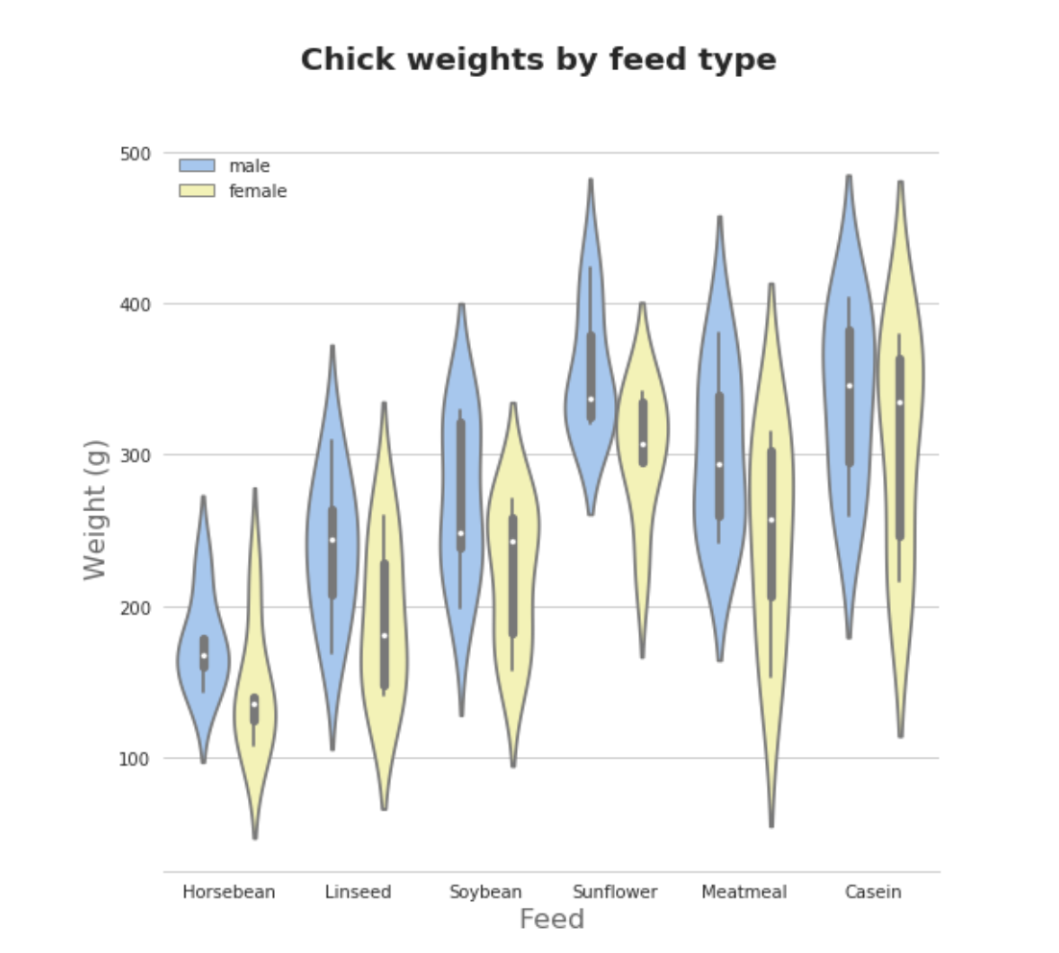
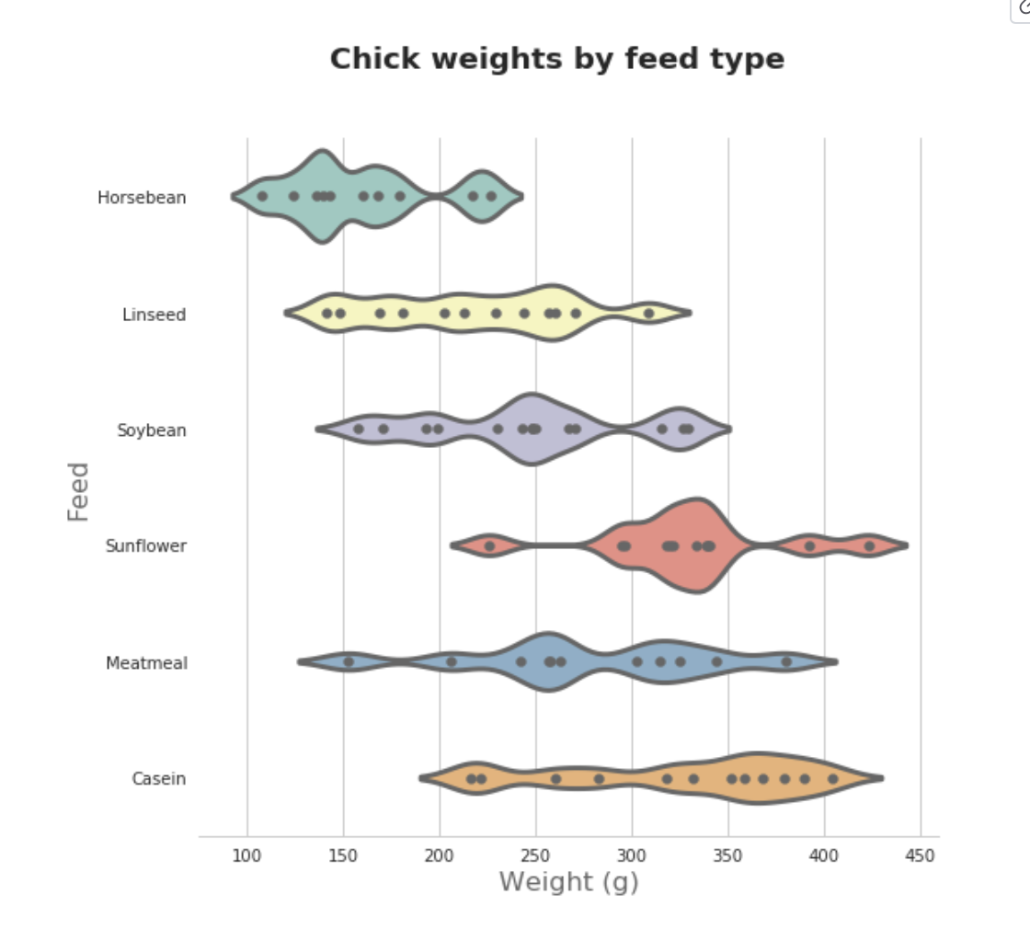
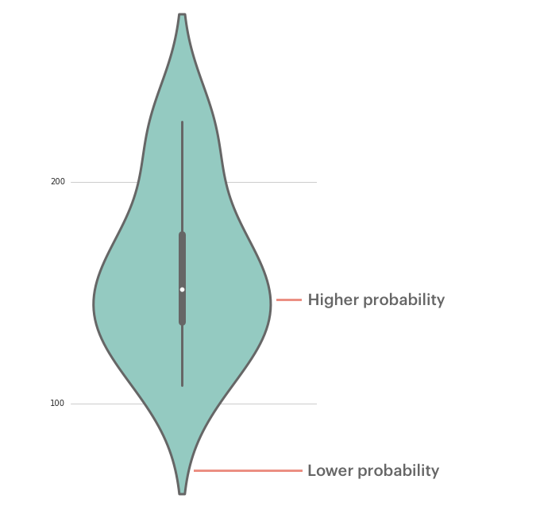
What are violin plots?
A violin plot is a method of plotting numeric data that is similar to a box plot, with the addition of a rotated kernel density plot on each side
Individual density curves are built around the center lines rather than stacked at the baselines like typical KDP
Yi, M. (2019). A complete guide to violin plots. Data Tutorials: Charts, Published in Chartio. https://chartio.com/learn/charts/violin-plot-complete-guide/
Notes:
A violin plot depicts distributions of numeric data for one or more groups using density curves. The width of each curve corresponds with the approximate frequency of data points in each region. Densities are frequently accompanied by an overlaid chart type, such as box plot, to provide additional information.
Violin plots are used when you want to observe the distribution of numeric data, and are especially useful when you want to make a comparison of distributions between multiple groups. The peaks, valleys, and tails of each group’s density curve can be compared to see where groups are similar or different. Additional elements, like box plot quartiles, are often added to a violin plot to provide additional ways of comparing groups
They are often combined with an additional method such as a box plot within (as seen above) or with plots such as: rug plots, jittered strip plots and swarm plots (similar to dot plots) where the distribution plots are overlayed. However, with large sample sizes this isn’t as ideal or telling as the box plots within. The goal with violin pots is to provide clarity to the reader or viewer and have transparency within the data.
They can be presented in tandem, multiple side by side, vertically, horiztonally,
https://datavizcatalogue.com/methods/violin_plot.html

Slide 3
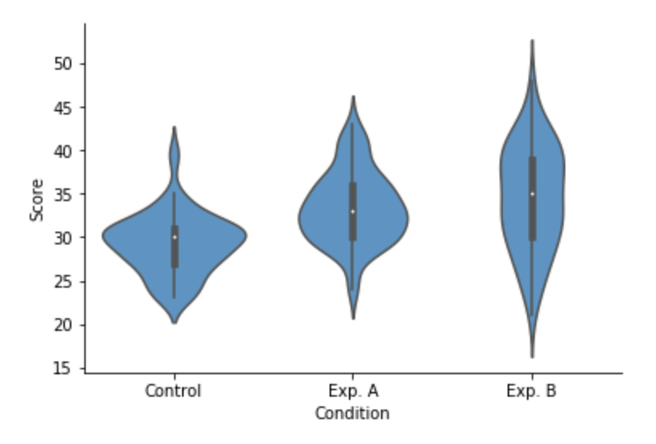
Violin plot example
Yi, M. (2019). A complete guide to violin plots. Data Tutorials: Charts, Published in Chartio. https://chartio.com/learn/charts/violin-plot-complete-guide/
Notes:
The example violin plot above depicts the results of a fictional experiment with one control group and two experimental conditions. In the middle of each density curve is a small box plot, with the rectangle showing the ends of the first and third quartiles and central dot the median. We can see from the plot that the two experimental techniques provided different benefits compared to the control. However, the second experimental condition (B) has a much more elongated distribution compared to the other two groups, without a distinct peak. The latter fact would have been missed with the box plot alone.

Slide 4
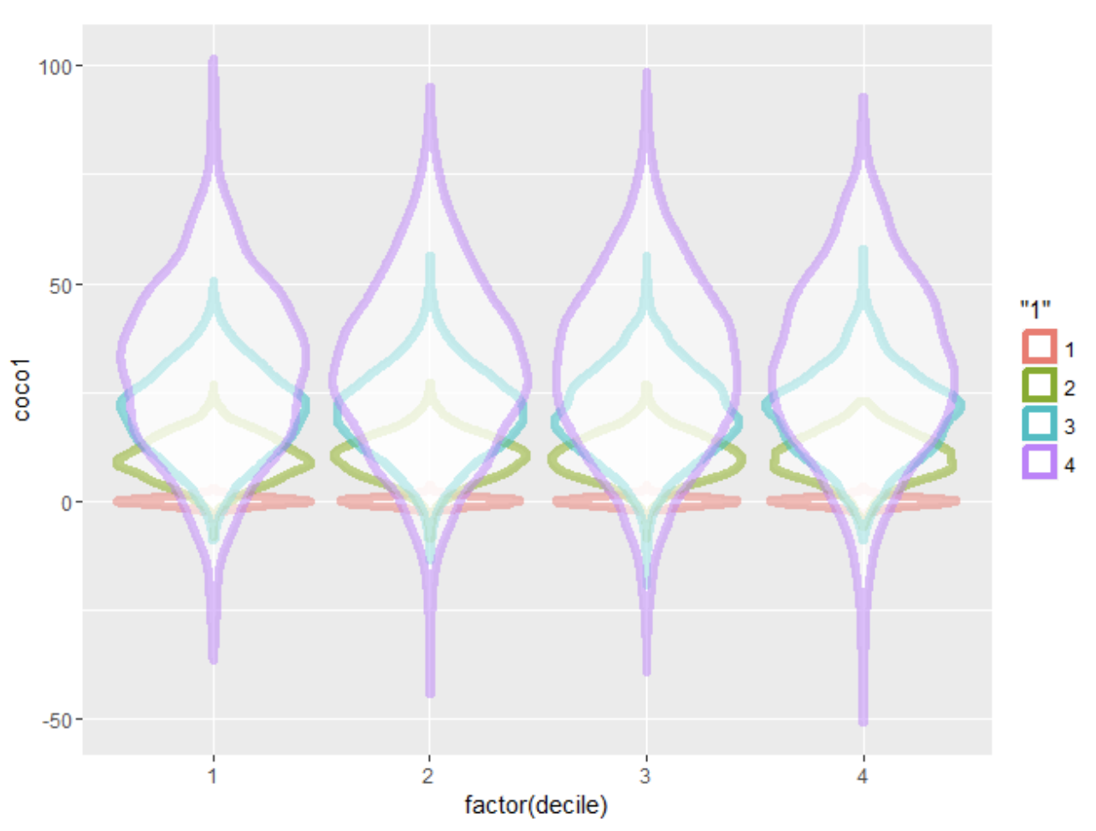
Why violin plots over box plots?
A violin plot is more informative than a plain box plot.
Shows the same summary stats as box plots, in addition to the full distribution of the data
Particularly useful when the difference is multimodal
Like box plots, violin plots are used to represent comparison of a variable distribution (or sample distribution) across different "categories"
A violin plot can have multiple layers. For instance, the outer shape represents all possible results. The next layer inside might represent the values that occur 95% of the time. The next layer (if it exists) inside might represent the values that occur 50% of the time.
Although more informative than box plots, they are less popular given the unfamiliarity with the representation
Notes:
A violin plot is more informative than a plain box plot. While a box plot only shows summary statistics such as mean/median and interquartile ranges, the violin plot shows the full distribution of the data. The difference is particularly useful when the data distribution is multimodal (more than one peak). In this case a violin plot shows the presence of different peaks, their position and relative amplitude.
Like box plots, violin plots are used to represent comparison of a variable distribution (or sample distribution) across different "categories" (for example, temperature distribution compared between day and night, or distribution of car prices compared across different car makers).
A violin plot can have multiple layers. For instance, the outer shape represents all possible results. The next layer inside might represent the values that occur 95% of the time. The next layer (if it exists) inside might represent the values that occur 50% of the time.
Although more informative than box plots, they are less popular. Because of their unpopularity, their meaning can be harder to grasp for many readers not familiar with the violin plot representation.

Slide 5
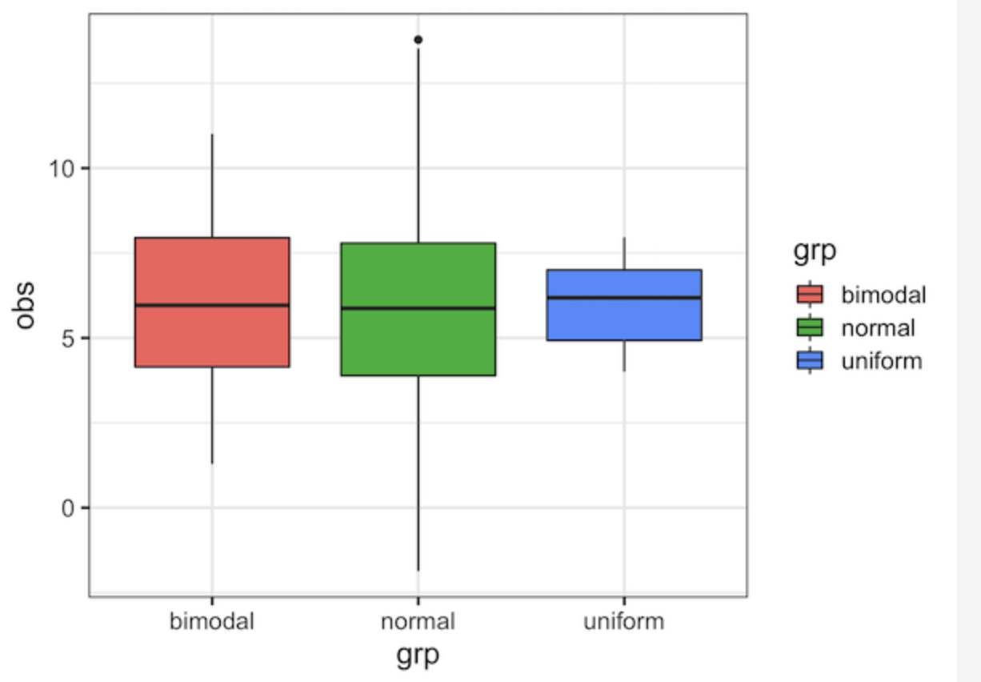
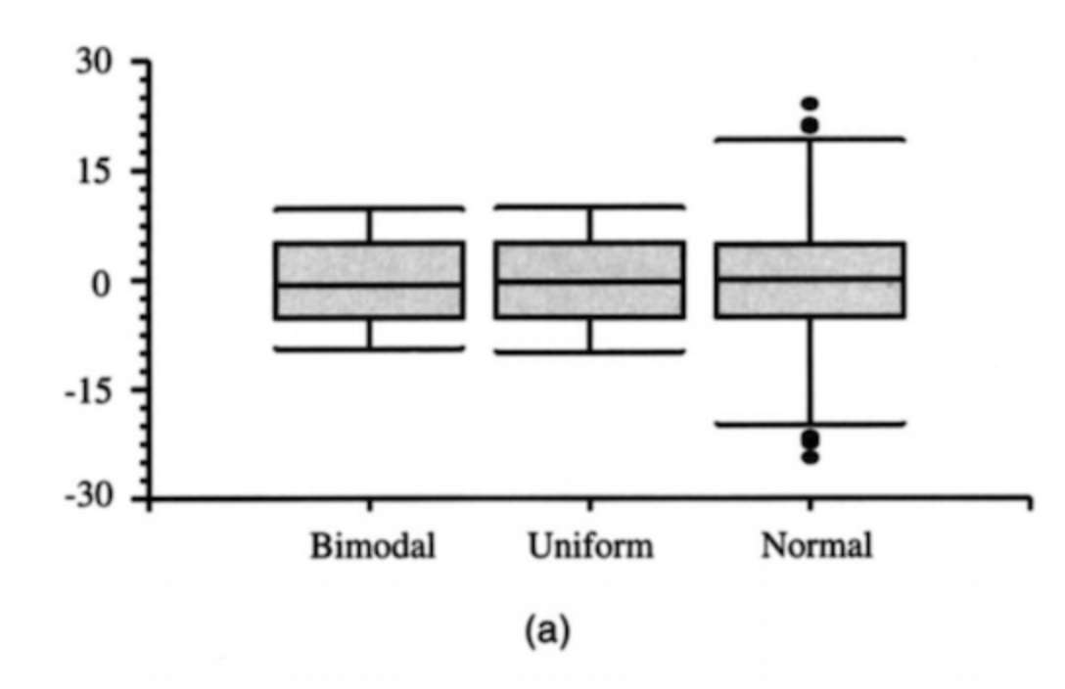
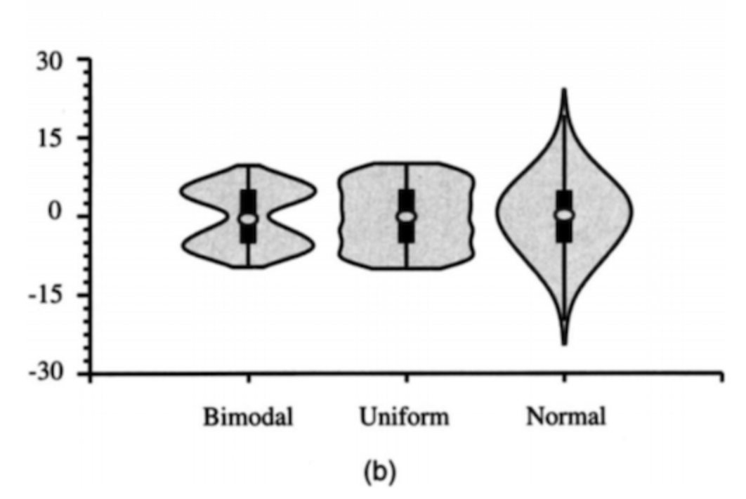
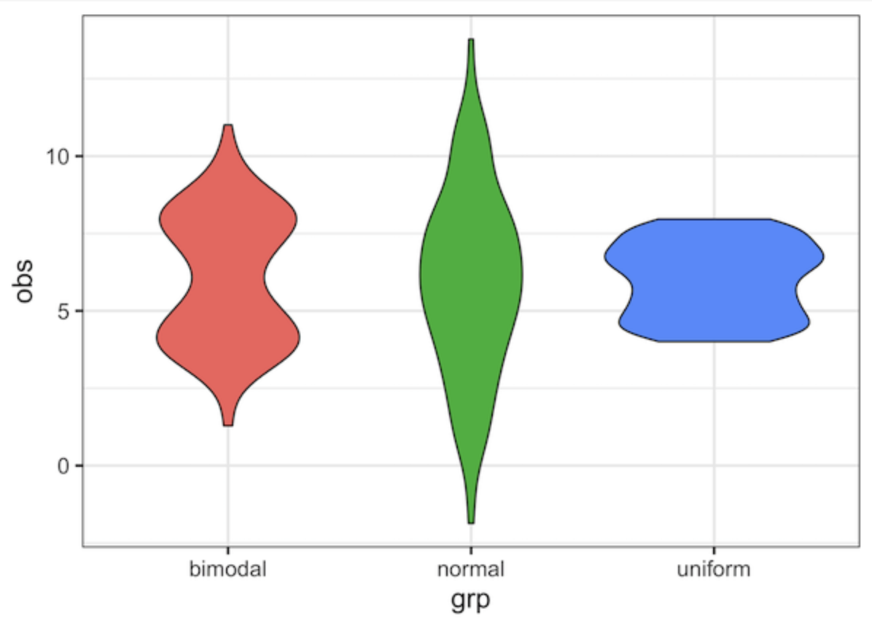
BOX PLOT VS. VIOLIN PLOT
Hintze and Nelson, 1998; https://datavizpyr.com/violinplot-vs-boxplot-when-violinplot-can-be-more-useful/

Slide 6
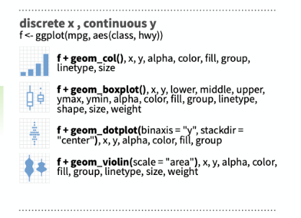
SOFTWARE PACKAGES FOR CREATING VIOLIN PLOTS
Violin plots are available as extensions to a number of software packages, including:
R packages vioplot, wvioplot, caroline, UsingR, lattice and ggplot2
Stata add-on command vioplot
Python libraries matplotlib, Plotly, ROOT and Seaborn
Notes:
Violin plots are available as extensions to a number of software packages, including the R packages vioplot, wvioplot, caroline, UsingR, lattice and ggplot2, the Stata add-on command vioplot,^{[5]} and the Python libraries matplotlib,^{[6]} Plotly,^{[7]} ROOT^{[8]} and Seaborn,^{[9]} a graph type in Origin,^{[10]} IGOR Pro,^{[11]} Julia statistical plotting package StatsPlots.jl^{[12]} and DistributionChart in Mathematica.

Slide 7
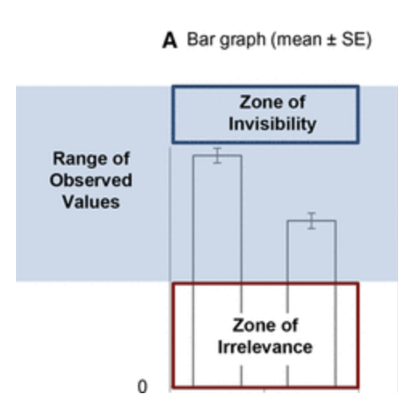
Take home Messages
Violin plots can be a better data visualization technique that promotes transparency by providing more clear, meaningful data points that other techniques cannot offer
They can be particularly telling when there are varying distributions that offer important information to the reader
They are not appropriate for all forms of data and consideration of your sample size should be given

Slide 8
References
Hintze and Nelson, 1998; https://datavizpyr.com/violinplot-vs-boxplot-when-violinplot-can-be-more-useful/
Thrun, Michael C.; Gehlert, Tino; Ultsch, Alfred (2020-10-14). Vafaee, Fatemeh (ed.). "Analyzing the fine structure of distributions". PLOS ONE. 15 (10): e0238835. doi:10.1371/journal.pone.0238835
Weissgerber, T., Winham, S., Heinzen, E., Milin-Lazovic, J., Garcia-Valencia, O., Bukumiric, Z., Savic, M., Garovic, V. & Milic, N. (2019). Reveal, don’t conceal: Transforming data visualization to improve transparency. Circulation, 140(18), 1506 – 1518. https://doi.org/10.1161/CIRCULATIONAHA.118.037777
Weissgerber, T., Savic, M., Winham, S., Stanisavljevic, D., Garovic, V., & Milic, N. (2017). Data visualization, bar naked: A free tool for creating interactive graphics. Journal of biological chemistry, 292(50), 20592 – 20598. https://doi.org/10.1074/jbc.RA117.000147
Yi, M. (2019). A complete guide to violin plots. Data Tutorials: Charts, Published in Chartio. https://chartio.com/learn/charts/violin-plot-complete-guide/
Notes:
Violin plots are available as extensions to a number of software packages, including the R packages vioplot, wvioplot, caroline, UsingR, lattice and ggplot2, the Stata add-on command vioplot,^{[5]} and the Python libraries matplotlib,^{[6]} Plotly,^{[7]} ROOT^{[8]} and Seaborn,^{[9]} a graph type in Origin,^{[10]} IGOR Pro,^{[11]} Julia statistical plotting package StatsPlots.jl^{[12]} and DistributionChart in Mathematica.

